Slide 1
Project discussion: Song recognition
Made by:
Anna Derevianko
Ivan Yuzvyshyn
Maryam Zahra

Slide 2
Overview
Introduction
Why This data? 3. Exploratory Analysis
Description of data set 4. Unsupervised Learning
Gathering all the data set 5. Supervised learning
6. Conclusion
2. Data Cleaning

Slide 3
Why this data ?
Can’t remember a familiar song in the club or the restaurant. But the sentimentality of the song really touches your heart. You desperately want to heart it tomorrow.
You have a phone with music recognition software installed so the software tell you the name of the song, and you know that you can hear it again and again until it becomes a part of you…or you get sick of it.
Wanted to add something similar to software recognition in our application so we changed data

Slide 4
Description of Data Set
Our data set includes
songs titles
Author
Genre
song fingerprints.

Slide 5
Gathering all data set
Folder with songs in wav format
From song we have author, title, genre and fingerprint
Converting each song into bytes array
Byte array signal is recorded in time domain
Splitting byte array of each song into intervals
convert our signal from the time domain to the frequency domain by discrete Fourier transform(DFT)

Slide 6
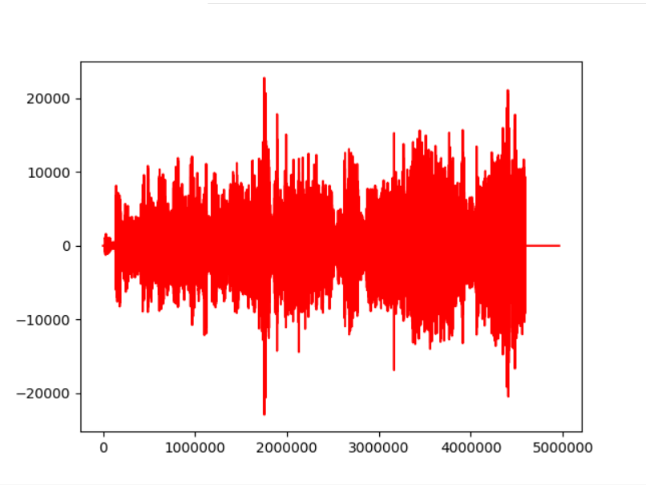
Representation of one song into byte format

Slide 7

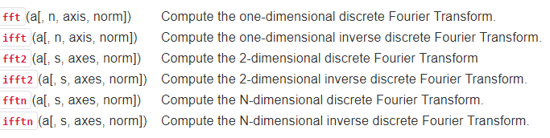
Gathering all data set
Discrete Fourier Transform
The DFT Formula is defined by
numerical algorithms for the calculation of DFT is the Fast Fourier transform (FFT). By far the most commonly used variation of FFT is the Cooley–Tukey algorithm.
This is a divide-and-conquer algorithm that recursively divides a DFT of any composite size into many smaller DFTs of sizes
Standard Library of FFTs

Slide 8
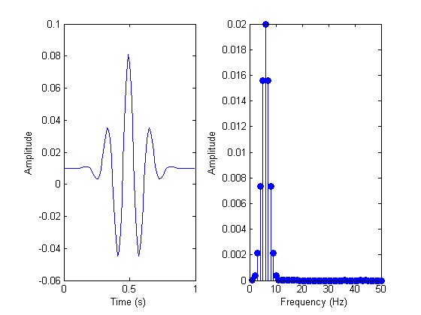
Signal before and after FFT Analysis

Slide 9
Gathering of Data set
Using chunk of data to know at what point of time each frequency appeared in song.
For instance if we record the sound, in stereo, with 16-bit samples, at 44,100 Hz, one second of such sound will be 44,100 samples * 2 bytes * 2 channels ≈ 176 kB. If we pick 4 kB for the size of a chunk, we will have 44 chunks of data to analyze in every second of the song.
we iterate through all the chunks and perform FFT analysis on each.
The range of strong frequencies may vary between low C - C1 (32.70 Hz) and high C - C8 (4,186.01 Hz). This is a huge interval to cover.
Lower tones High tones
30 Hz - 40 Hz, 120 HZ-180 HZ
40 Hz - 80 Hz 180 HZ-300 HZ
We can simply identify the frequency with highest magnitude.
This information become signature and signature becomes fingerprint of the song.

Slide 10
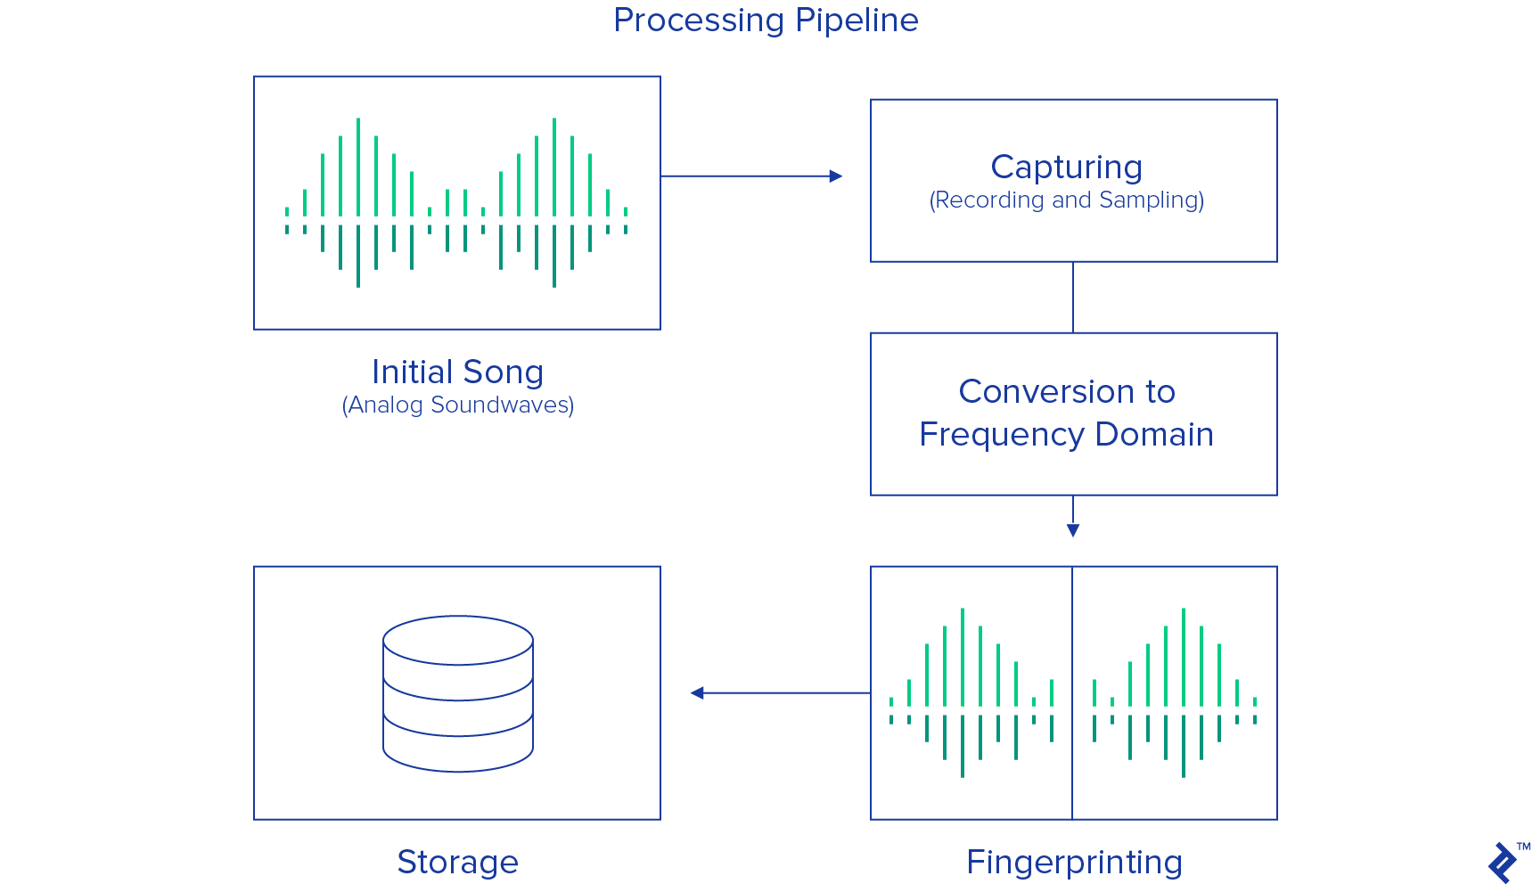
Summary of music recognition

Slide 11
2. Data Cleaning
Each song have different length and frequencies, so cleaning data is important.
If length of one song is shorter than the other we are adding the zeros frequency in the end so that the length of songs are same and adding zeros frequency means we are adding the silence.

Slide 12
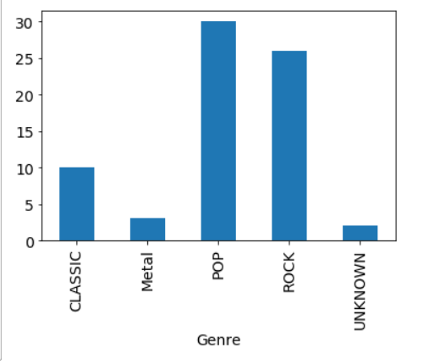
3. Explanatory Analysis

Slide 13
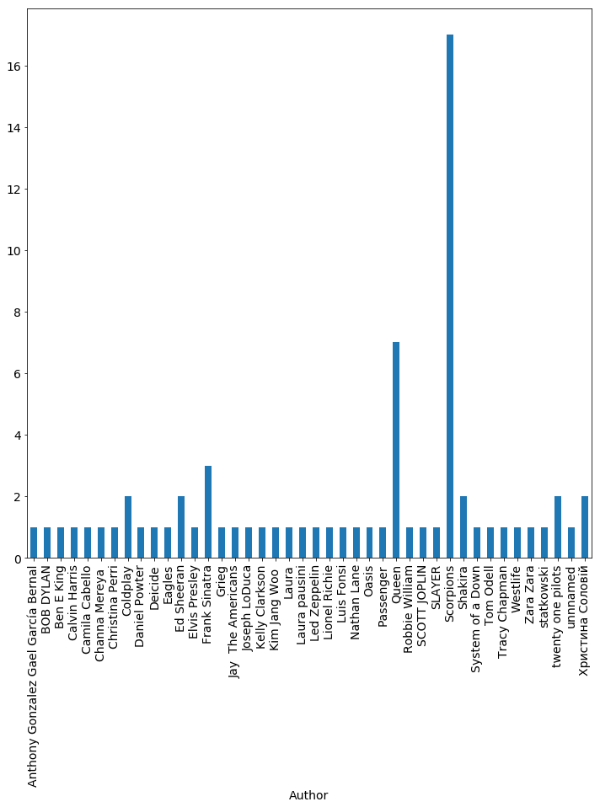

Slide 14
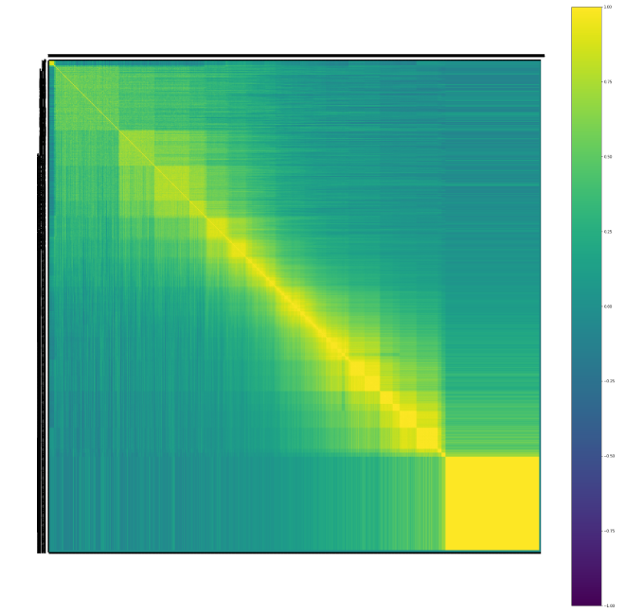
Correlation matrix
Each random variable(X_{i}) in the table is correlated with each of the other values in the table (X_{j}).
allows to see which pairs have the highest correlation.
The diagonal of the table is always a set of ones because the correlation between a variable and itself is always 1.

Slide 15
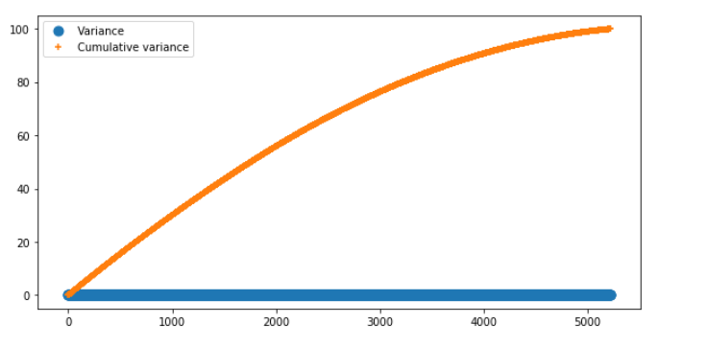
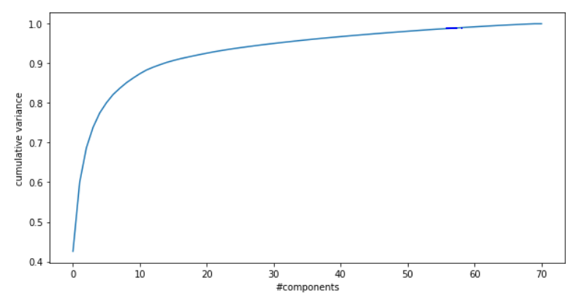
4. Unsupervised learning: PCA

Slide 16
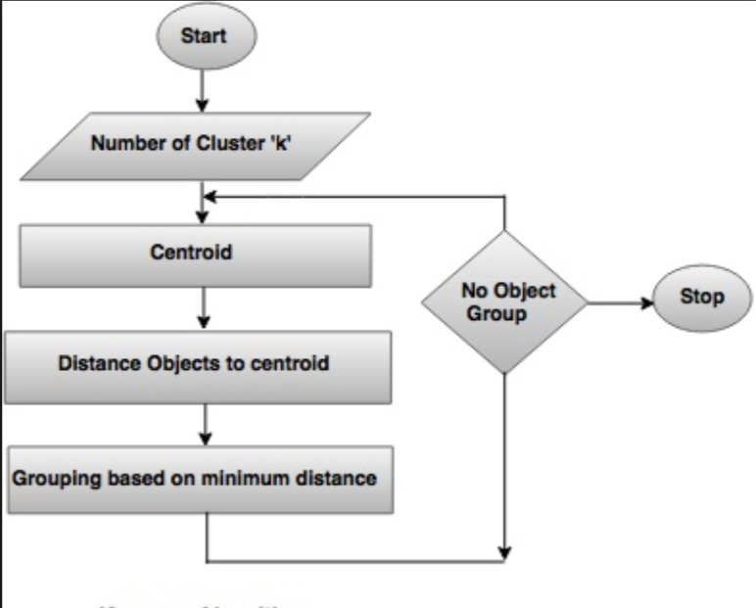
Unsupervised Learning
K-Means Algorithm

Slide 17
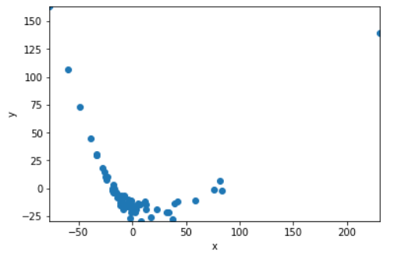
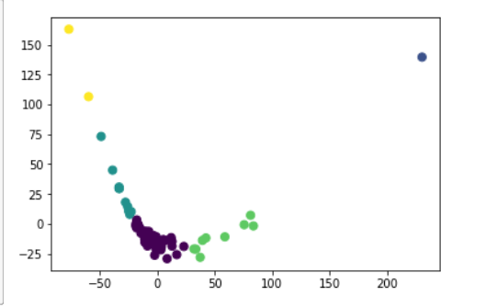
Unsupervised Learning
Clustering :

Slide 18
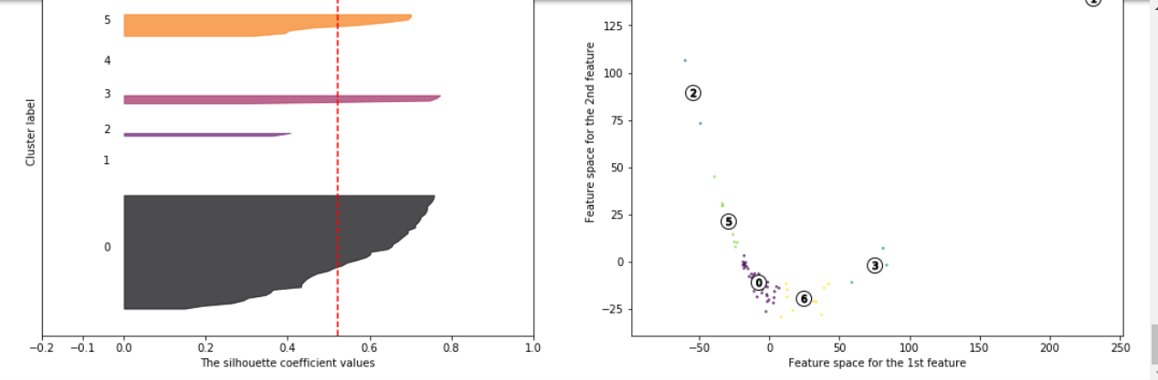
Unsupervised learning

Slide 19
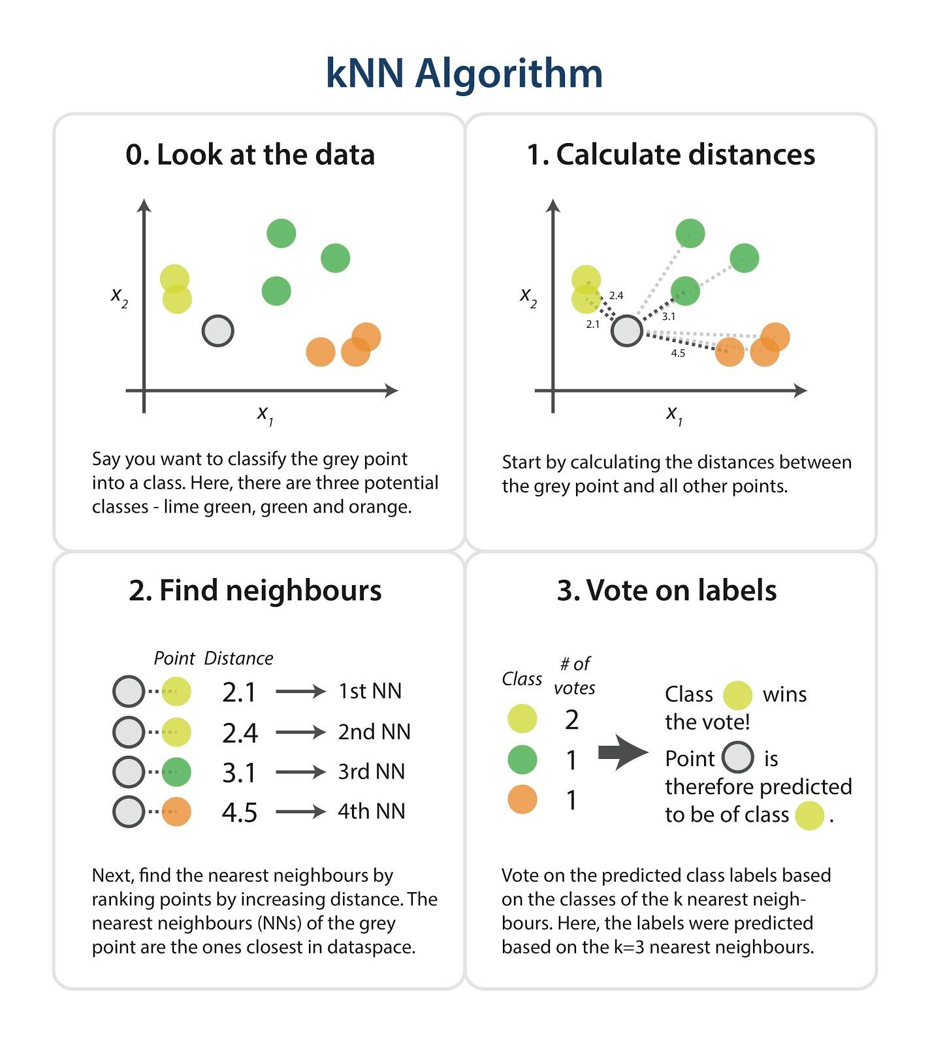
4. Supervised Learning: K-Nearest Neighbors Algorithm

Slide 20
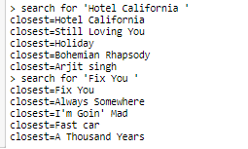
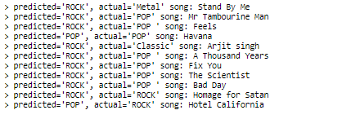
Results of KNN Algorithm

Slide 21
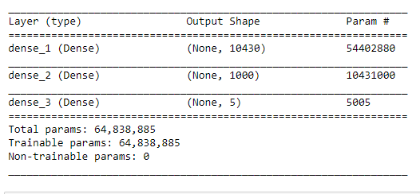
Results of supervised learning
The layers of our network are shown below

Slide 22

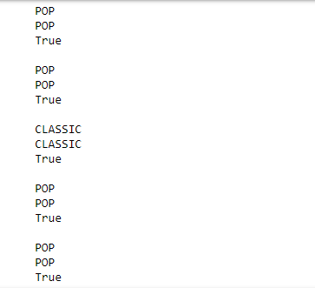

After teaching our network we got this results
We compare actual genre to predicted one, and that’s what we get as result

Slide 23


Slide 24
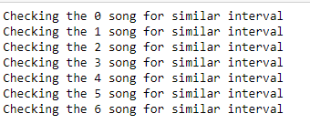

Shazam Algorithm
We took the small piece of random song ( # 6 in our database ) and we run the shazam algorithm, and result we have below

Slide 25
THE END

